Slide 1
Chapter 3 figures

Slide 2
7.5 mm
3 mm
100 nm Ge
30 nm SiNx
500 μm Si
Notes:
Sample_Geometry.png

Slide 3
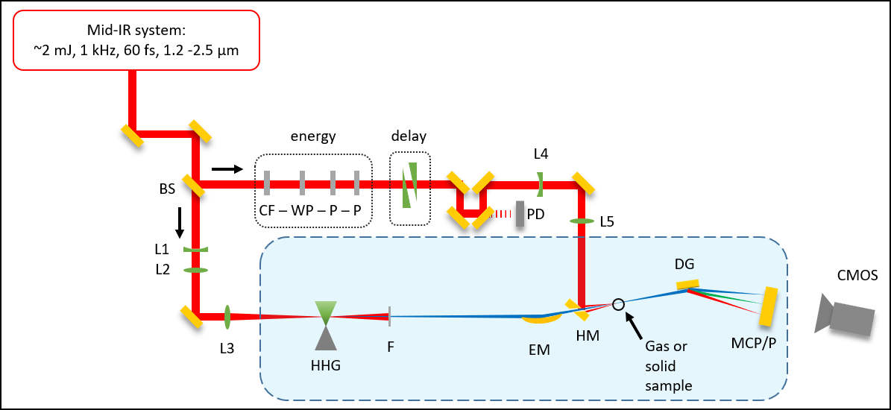
S
S

Slide 4
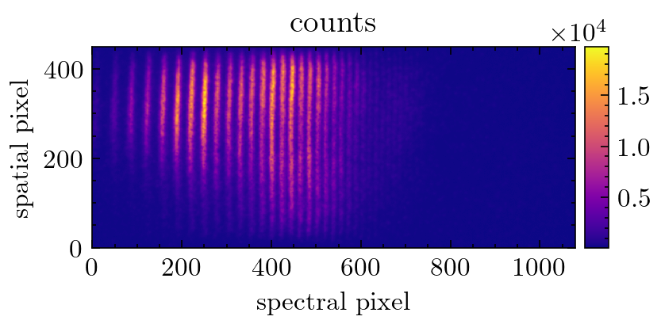
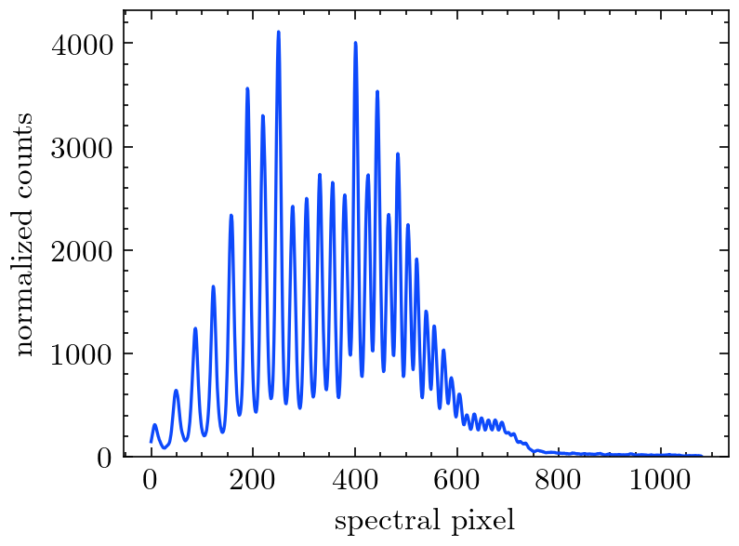
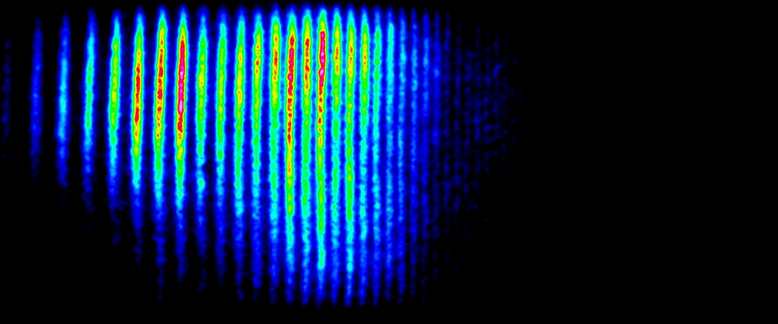
2D spectrometer image
Raw 2D image
Spectral lineout
Filtering
Delta-OD calculation
Delta-OD normalization
Average delta-OD
Energy calibration
Background subtraction, exposure time normalization, normalized spatial integration,

